Slide 1


The P.A.C.M.A.N Project
Group B: Madrid in Black
Madrid in Black​

Slide 2
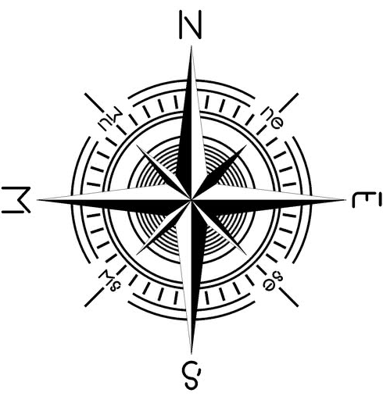
INDEX
INTRODUCTION
OBJETIVE
TECHNOLOGIES
GANTT DIAGRAM
THE CRAWLER
SYSTEM TESTING
ANALYSYS & CONCLUSIONS
BIG DATA
CONCLUSIONS

Slide 3

Introduction
What is P.A.C.M.A.N?
Promoting
Acquisition of
Competences in a
Multicultural and
Associative
Network
Purpose of the Project
The Idea
The P.A.C.M.A.N Project
Madrid in Black​

Slide 4
Schools and Students
Madrid in Black
Schools and Countries
Students
Carlow Institute of Further Education and Training from Carlow, Ireland.
IES El Lago from Madrid, Spain
SPS Na Proseku from Prague, Czech Republic
Hälsinglands Utbildningsförbund from Sörderhamn, Sweden
Spain - Sergio Castillo and Mateo Sagaseta
Czech - Michael Kazda and Michal Dvořák
Sweden – Johan Larm and Knut Lundgren
Madrid in Black​

Slide 5


The Companies
BInfluencer and Grupo OneTec
Support and Supervision
BInfluencer
Grupo OneTec
Madrid in Black​

Slide 6

The Objective
Tasks, Ideas and Teamwork.
The Main Goal
Crawler/Spider
TiKToK
Scraping
MongoDB
Pandas and Matplotlib
Creating Bridges
Madrid in Black​

Slide 7

Technologies
We have used several kinds of technology in this project.
Python
MongoDB
Pandas
Matplotlib
Jupyter Notebook
GitHub
Microsoft Teams
Madrid in Black​

Slide 8
GANTT DIAGRAM

Slide 9
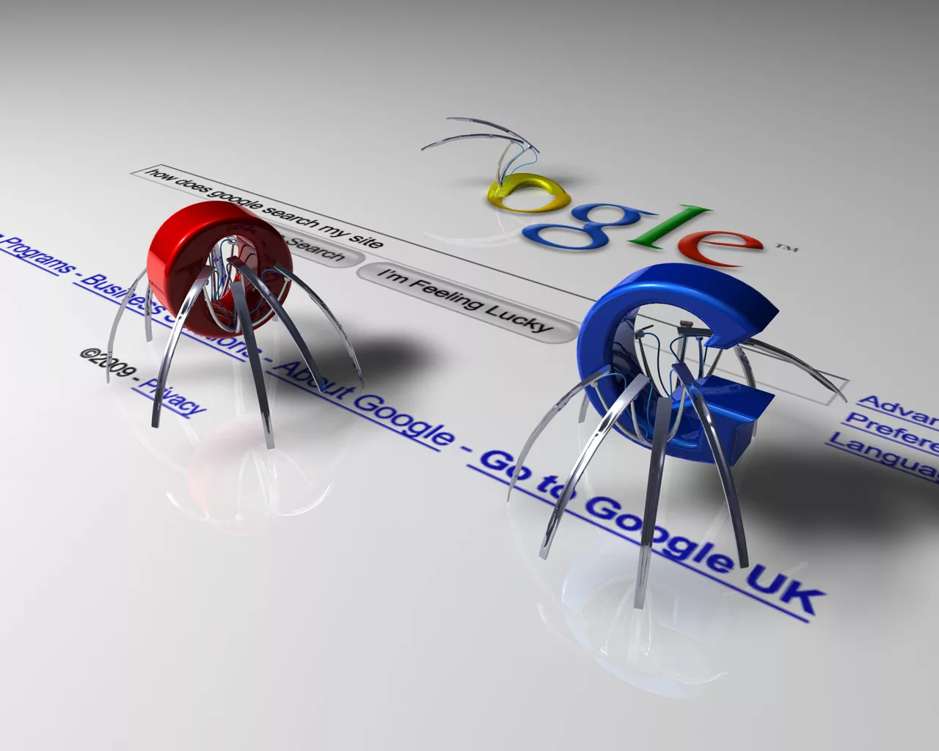
The Crawler
Scraping Code
Setting up
Initial user profile links
User profile data
User media data

Slide 10
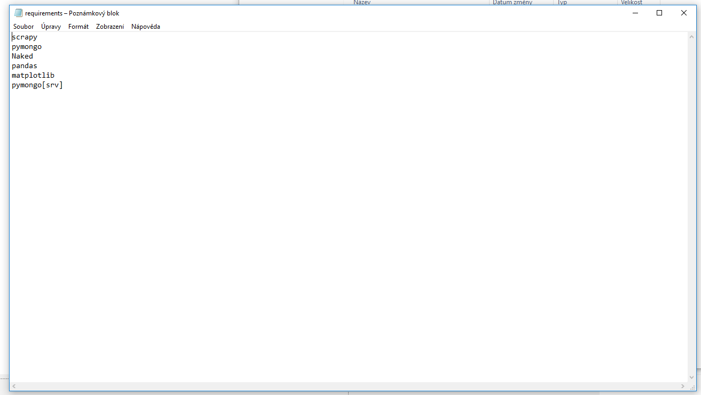
requirements.txt
Installing all used modules
Automatically using pip
More user friendly

Slide 11
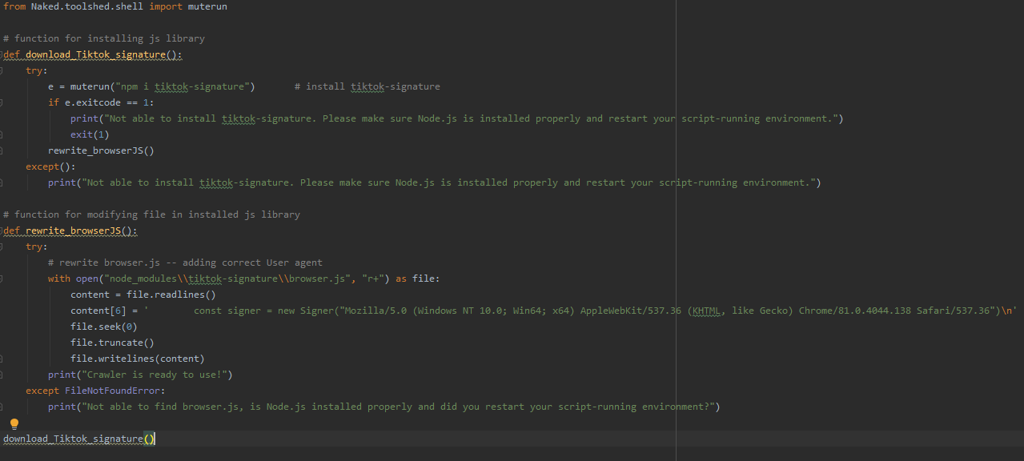
setup-nodejs.py
Downloading Tiktok-signature lib
To know the exact path
Modifying browser.js file
More user friendly

Slide 12
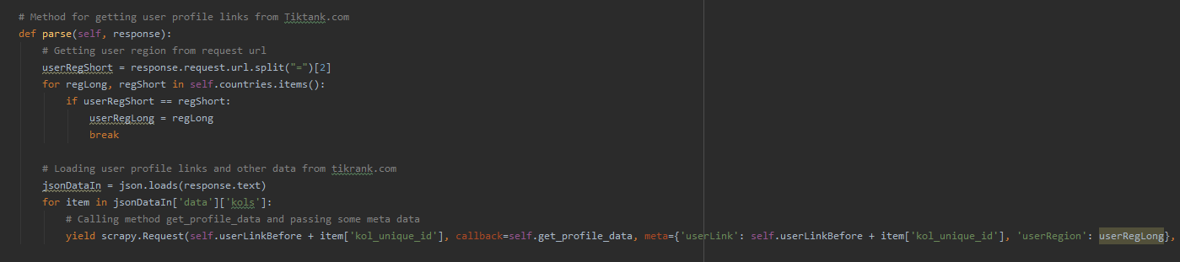
Initial user profile links
User links from Tikrank.com
User region info
New Scrapy request, passing some data

Slide 13
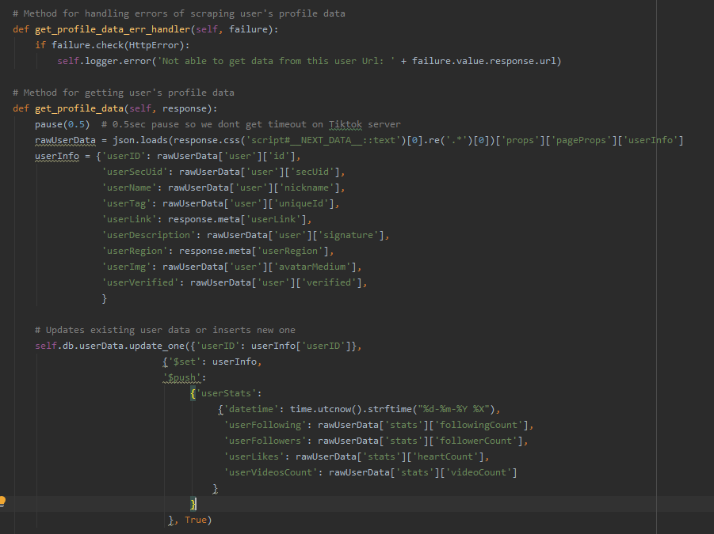
User profile data
Obtaining profile data from Tiktok
Website update proof
Data from json not html
Storing into mongoDB
Overwriting profile data
Adding user stats data

Slide 14
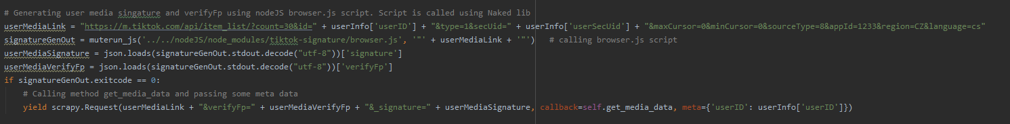
Generating signature
Generating with Tiktok-signature lib
Called by Naked lib
Using cmd with Python
Another Scrapy request

Slide 15
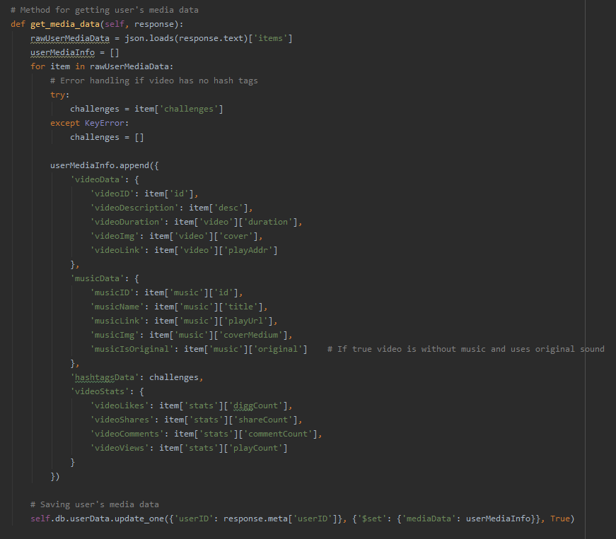
User profile data
Getting info about user content
Error handling
Saving into db
Overwriting

Slide 16

Problems and Solutions
User media data
Signature issue → Tiktok-siganture lib solution
Node.js issue → Naked lib solution
Path issue → setup-nodeJS.py script solution
MongoDB
Overwrite or add data
Server timeout
Setting pause
Madrid in Black​

Slide 17

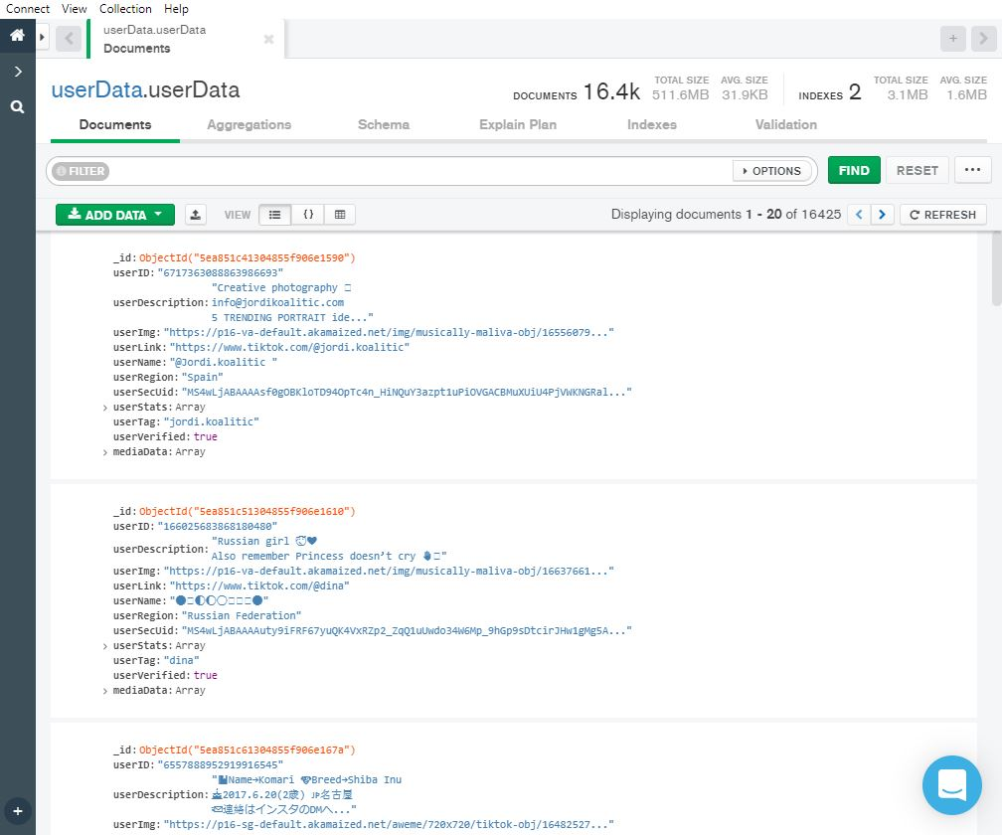

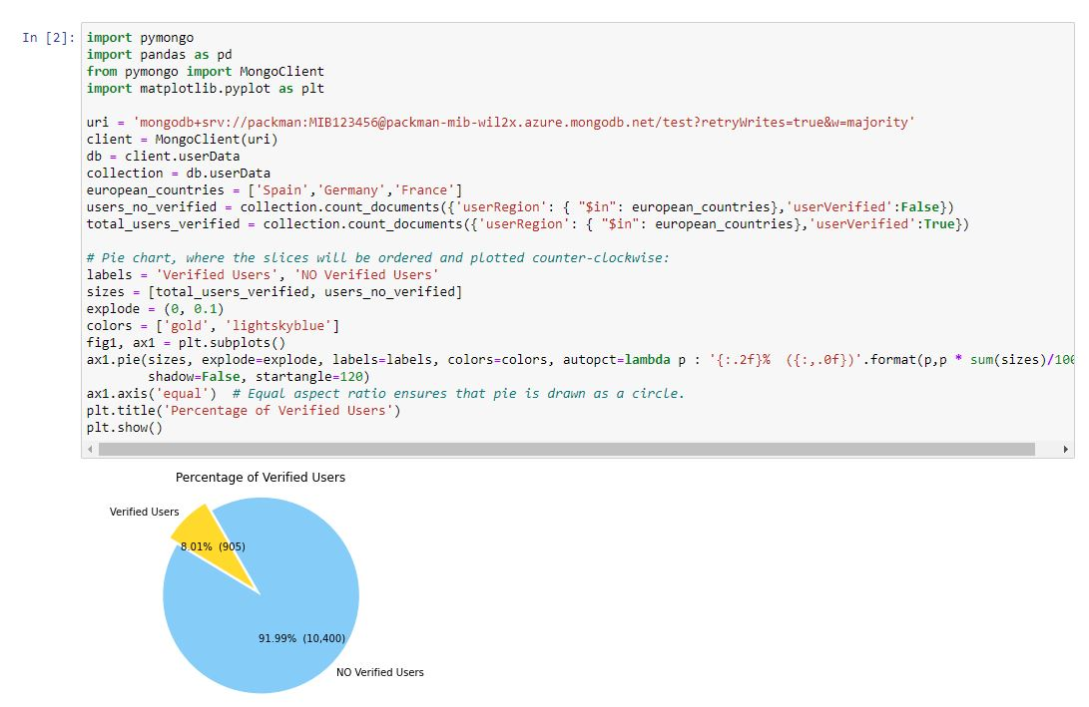

System Testing
MongoDB Compass.
Jupyter Notebook.
Tested that everything has been stored correctly and testing the graphs.
Madrid in Black​

Slide 18
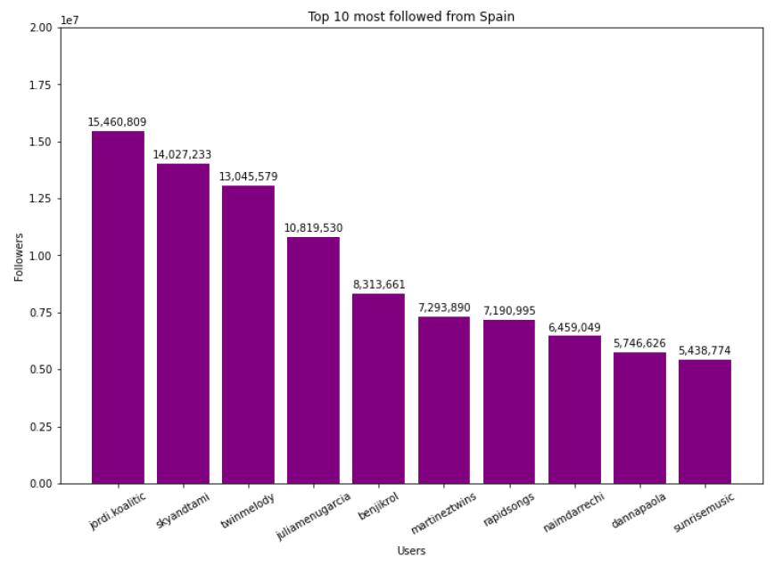
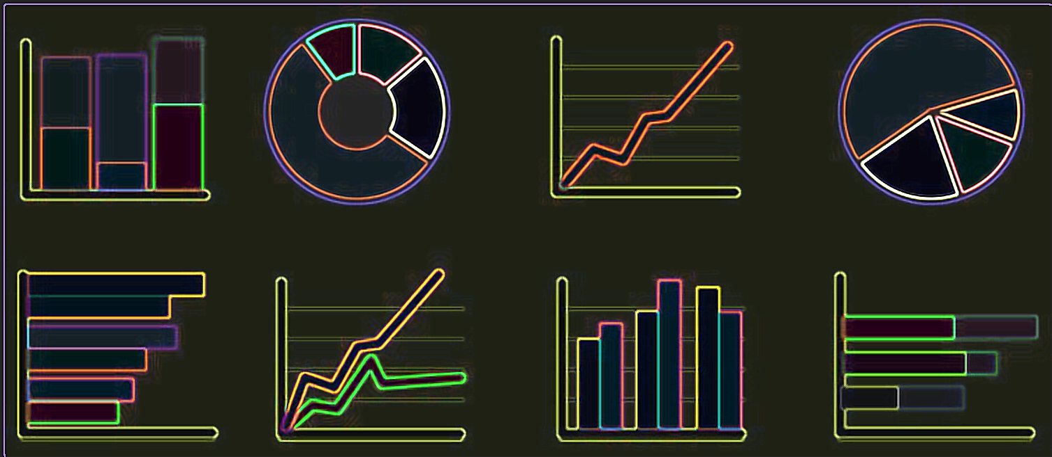
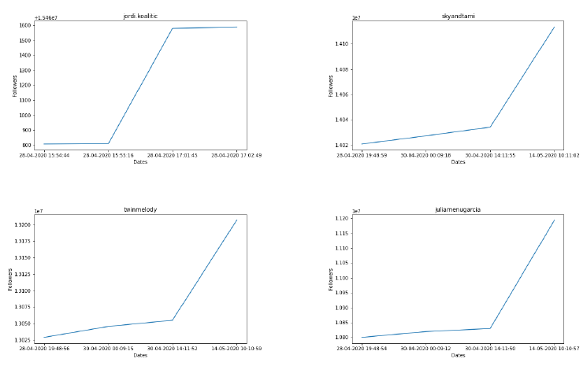
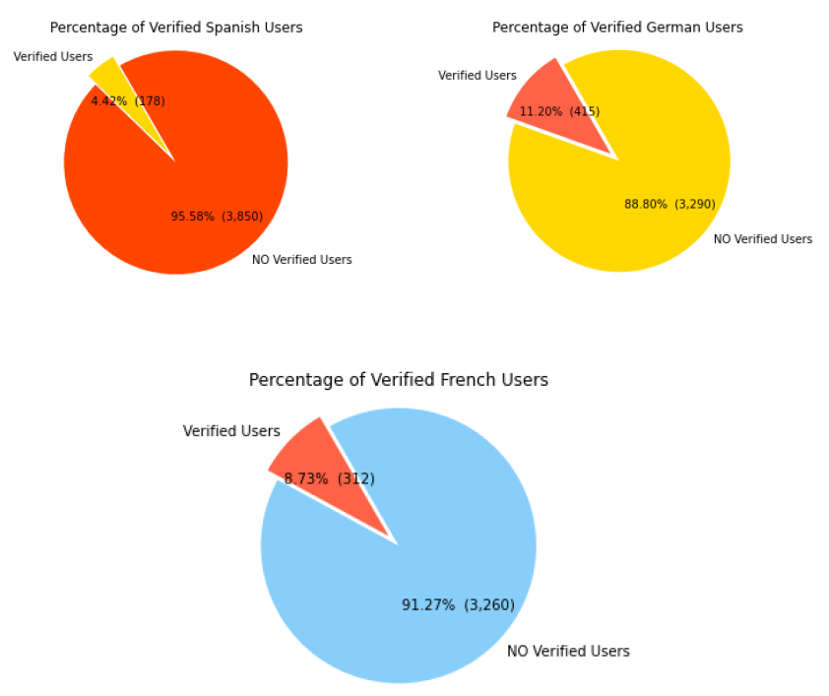
ANALYSIS
GRAPHS AND RESULTS

Slide 19




Big Data
The four stages of the information management cycle:
1º Information acquisition
3º Management
2º Storage
4º Analysis and conclusion
Madrid in Black​

Slide 20

Conclusions
Two final conclusion
Scraped data from Tik Tok
The meaning of an international project
It is not the end... It just the beginning
Madrid in Black​

Slide 21

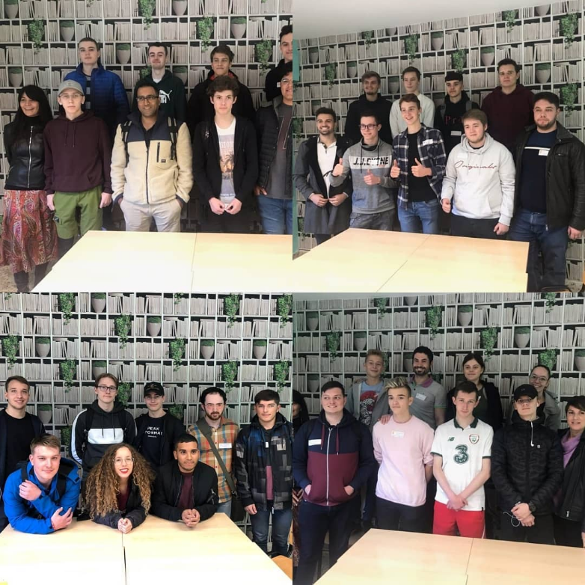
Thanks for your attention!
The P.A.C.M.A.N Project
Madrid in Black

Slide 22

Organization and Skills
Communication
Initiative
Problem Solving
Conflict Result & Critical Thinking
Decision Making
Willingess to Learn & Enthusiasm
Teamwork & Cooperation
European Culture
Madrid in Black​

Slide 23

Organization and Skills
Organization
First Stage
Second Stage
Third Stage
Fourth Stage
Fifth Stage
Final Stage
Responsibility
Learn Python
Make the Spider
Store it in MongoDB
Make Graphs
Organization and Responsibility
Madrid in Black​

